Slide 2
In 2017, while completing his own personal treatment, founder and CEO, Jeff Hardy, was shaken by the untimely death of a close friend of his, due to a fentanyl overdose. This event inspired him to take action.

Slide 3
His solution? Smart technologies that would bring emergency responders directly to people who have overdosed.

Slide 4
With this, Lifeguard App was born!

Slide 5
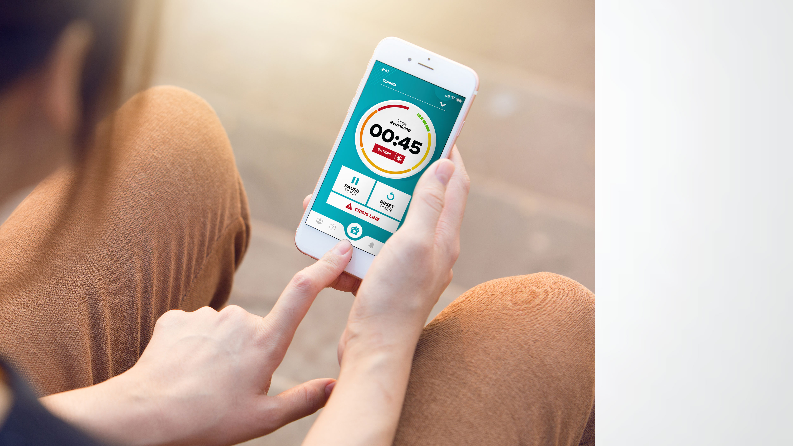
Lifeguard App
You’ll Never Use Alone Again.

Slide 6
Lifeguard App is a smartphone and tablet based application that, once enabled, automatically connects a drug user, whether habitual or recreational, to emergency responders if the user becomes unconscious and unable to function.

Slide 7
The app puts the control in the hands of the user, and it arms the emergency responders with information that is vital to the success of emergency interventions.

Slide 8
Since 90% of overdoses occur when users are alone and in their own spaces, a user directed app is critical for timely intervention.

Slide 9
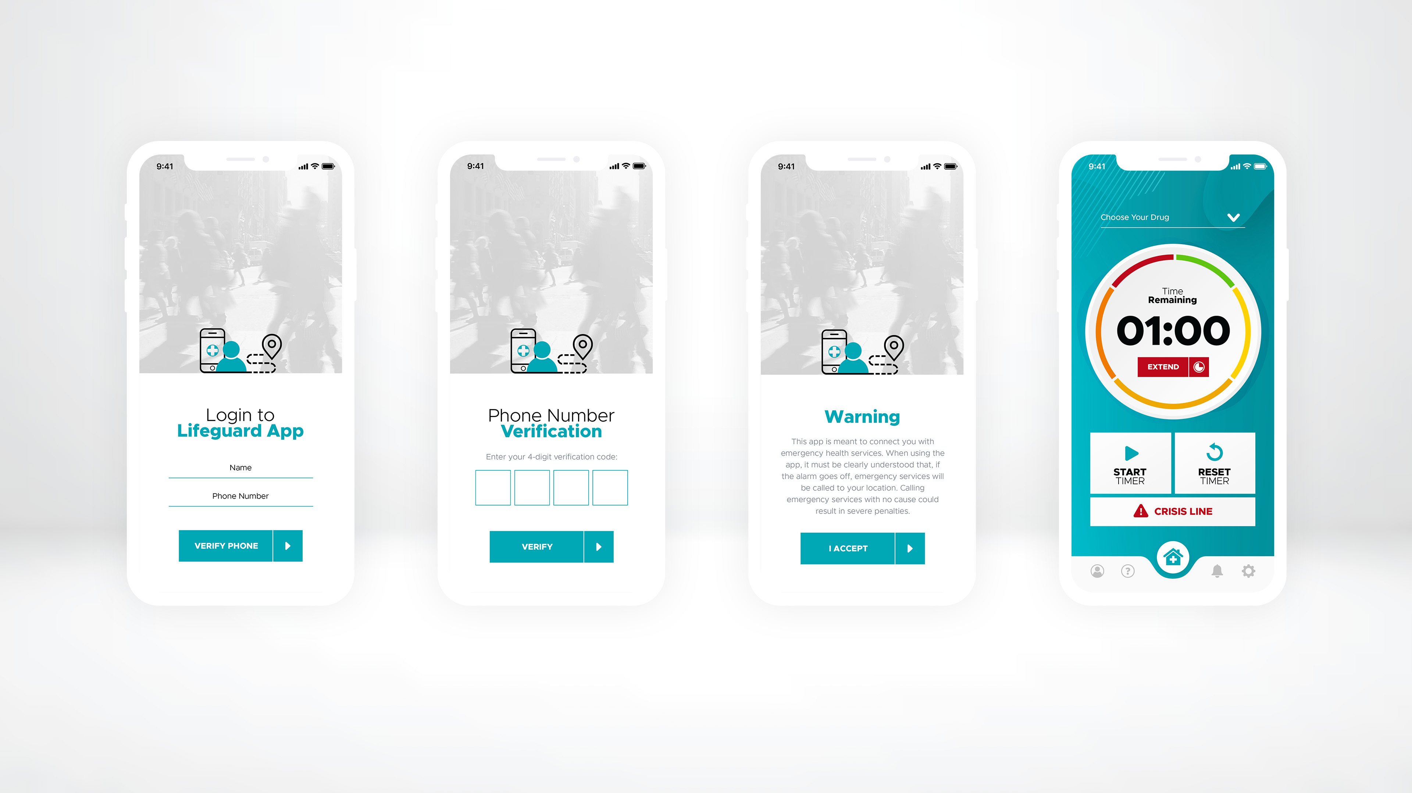
The user enters their name and contact number.
The user enters the two-factor verification code that was sent to their phone via text message.
The user accepts the warning that the app will contact emergency services.
The Home Screen is displayed.

Slide 10
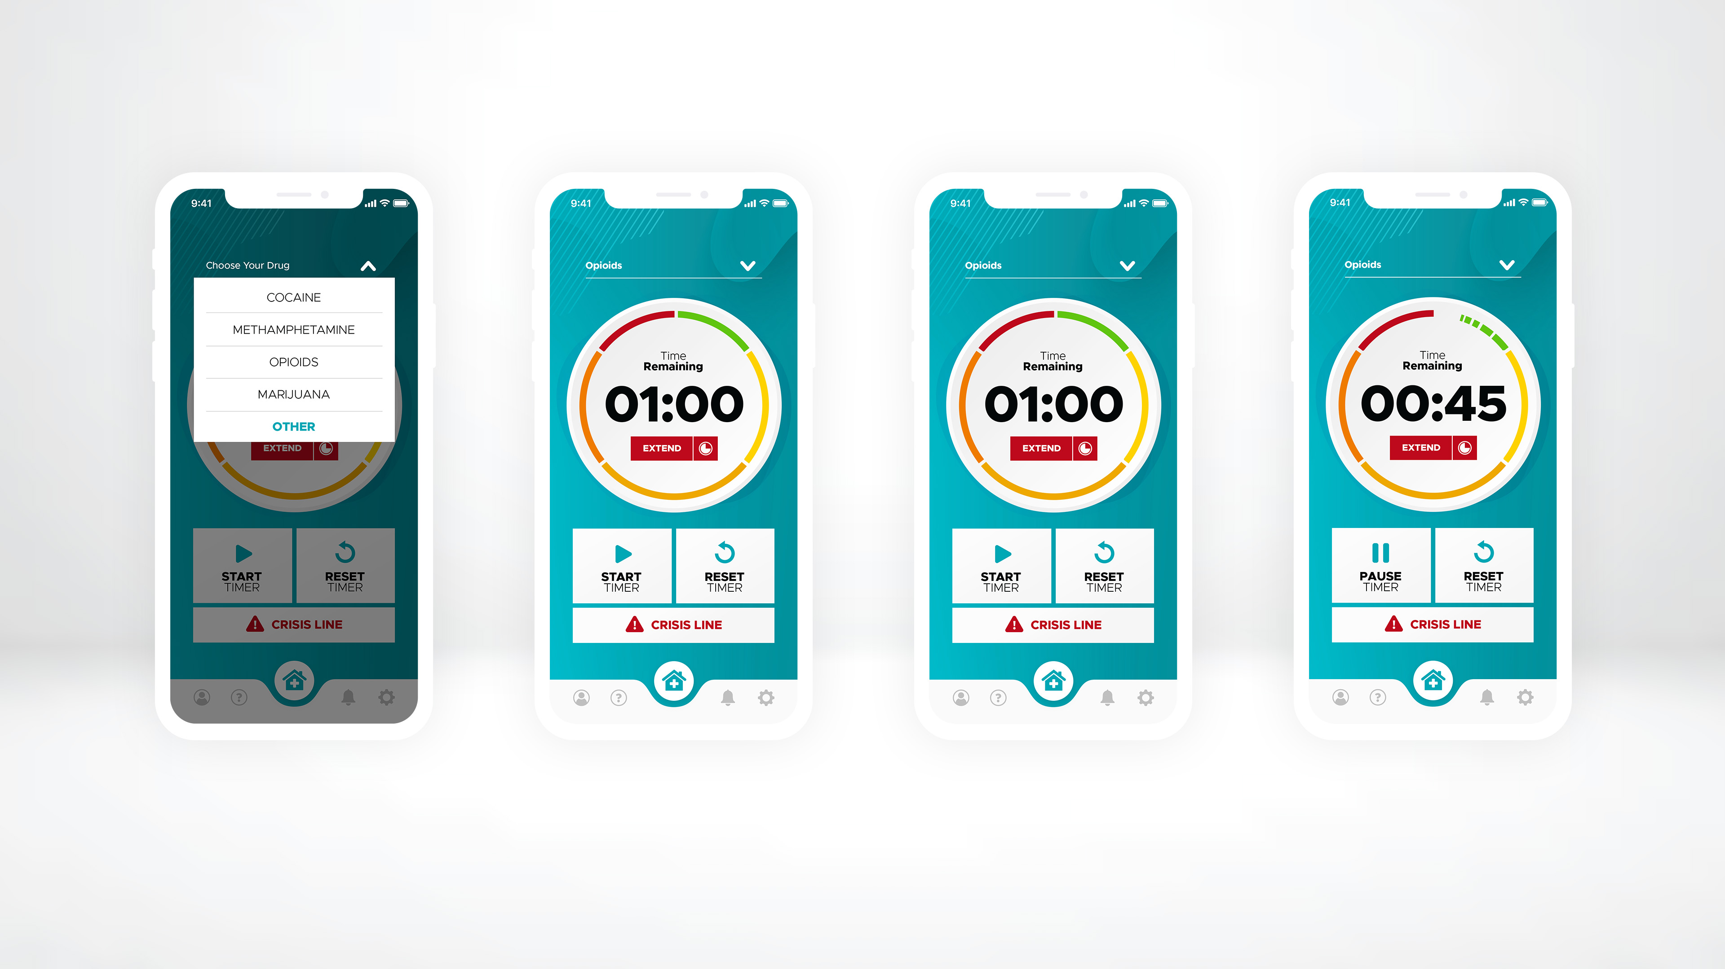
The list of drugs is displayed.
The user selects the drug they will be using.
The Start button is tapped to start the timer.
The timer starts running. If the user needs more time before the timer starts, they tap the Pause button.

Slide 11
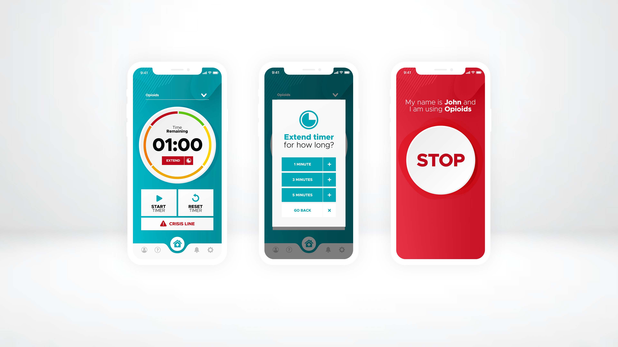
When the user is ready, they tap the Start button.
To increase the length of the timer, the Extend button is tapped, and a time is selected.
At 10 seconds remaining, an alarm will ring. When the timer ends, the Stop button is tapped to shut off the alarm.

Slide 12
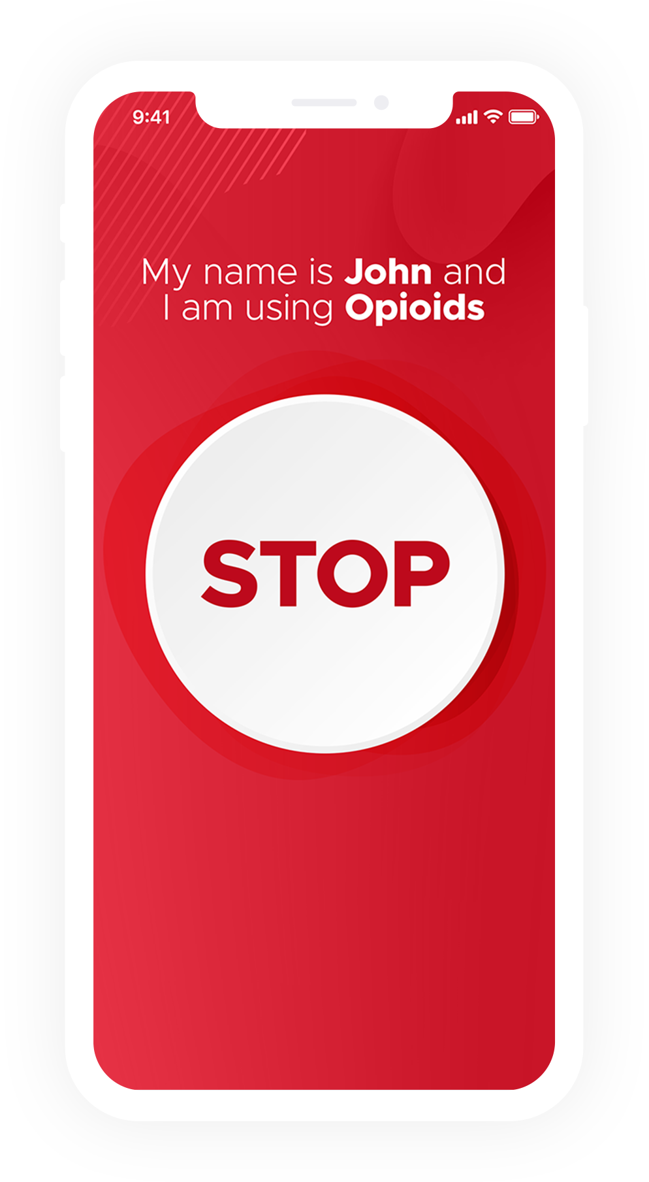
Geo-Fencing
GPS location used.
Specific functionalities based on users location.
Targeted push notifications.
Alternative alerts instead of 9-1-1.
Fully customizable to select towns, cities or provinces.
Restrict access in areas if required.
Admin panel for each HA to have more control.
User centered.

Slide 13
Technology Partnership
In 2019, Lifeguard Digital Health partnered with Microsoft to scale up their multiple digital solutions to expand availability globally. The partnership enables the company to focus on the provision of the application rather than managing the cloud infrastructure.

Slide 14
Research & Development
In partnership with Microsoft Inc. and the MyPDX blockchain team from Canada’s Digital Technology Supercluster (lead by MolecularYou Co. and UBC), we are building a digital platform linking the smartphone app interface, fortified for privacy and security, with permission blockchain technology. The platform will also use Artificial Intelligence (AI) to build machine learning algorithms (MLAs) for enhanced data analysis and train predictive models for enabling future public health harm reduction strategies.

Slide 15
Our Executive Team
Jeff Hardy, Founder Chief Executive Officer
Fern Hardy Finance and Administrative Officer
Chandana Unnithan, Ph.D., MBus. Computing, MBA Chief Technical and Informatics Officer
Brent Gasiorowski, Chief Marketing Officer
Ken Oliver, LLB Corporate Legal Counsel Strategist Corporate Partnerships
Our Advisors
Madeleine Hardin, MA. MEd Community Relations
Frank Holler Corporate Strategies
Anne Graham Best-Selling Author, Speaker
Brent Hardy Business Strategist
Marion Crook, BScN. PhD Public Heath
Anthony Huston Business Advisor and Board Member
Mitch Belobaba Pastor, Mental Health and Addictions Advocate

Slide 16
Our Consultants
Scott Jackson Team Lead, Technology Development & Implementation
Our United States Team
Andy Jones Director, U.S. Operations
Chris Callsen Strategist Emergency Services
Our Tech Support
Kevin Belobaba Team Lead, Help Desk

Slide 17
Our platform provides the necessary tools to put people's health into their own hands.
Lifeguard has a patent pending.

Slide 18
We are positioned to change the way healthcare systems operate and continue to save lives — around the world.
Lifeguard has a patent pending.

Slide 19
To learn more, visit LifeguardDH.com

